Slide 1
INDIAS AGRICULTURAL CROP PRODUCTION ANALYSIS(1997-2021)
G.MONISHA​

Slide 2
INDEX
TEAM DETAILS
EMPATHY MAP
BRAIN STORM
ANALYSES THE TABLEAU
​

Slide 3
TEAM DETAILS
TEAM LEADER
G.MOMISHA
TEAM MEMBERS
S.NIVETHA
E.PACHAMMAL
R.PRITHIGA

Slide 4
EMPATHY MAP
EMPATHY MAP IS UESD TO TOOL OF INDIAS AGRICULURAL CROP PRODUCTION ANALYSIS(1997-2021)

Slide 5
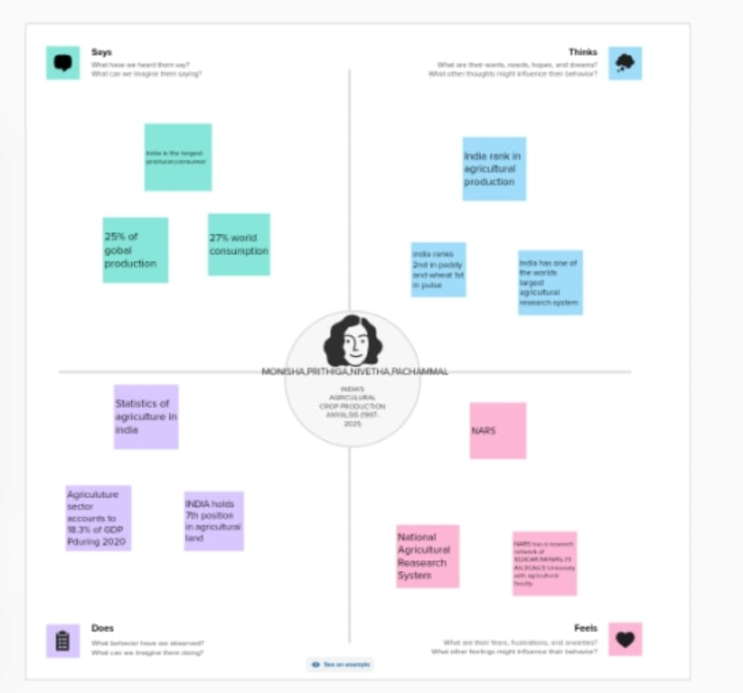

Slide 6
BRAIN STORMING
“
”
Brain storming is a group of creativity technique by which efforts are made to find a conclusion for a specific problem by gathering a list of ideas spontaneously contributed by its members

Slide 7
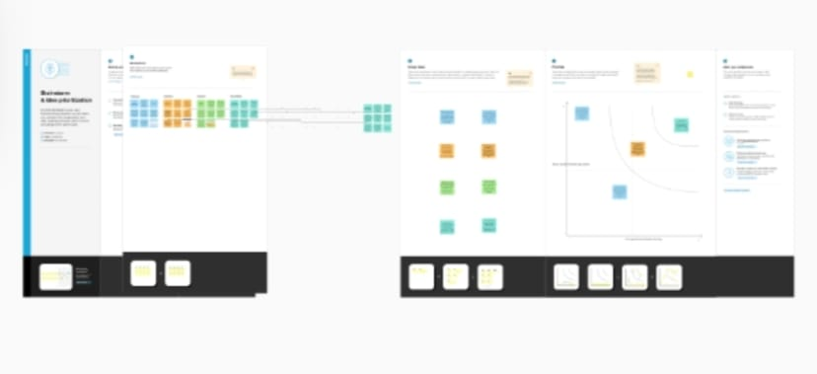
​

Slide 8
CONCLUSION
India is a large producer of several agricultural products. In terms of quantity of production, India is the top producer in the world in milk, and second largest in wheat and rice. Agricultural production is prone to several risks which affect both producers and consumers

Slide 9
THANK YOU

